Slide 1
Machine Learning at Intuit
5 Delightful Use Cases
Calum Murray
Chief Data Architect, Consumer Group, Intuit
May 24th 2018

Slide 2


Slide 3

Machine learning at Intuit
This talk is ...
An overview of how Intuit thinks of ML
A high-level view of some Intuit’s ML use cases
This talk is not ...
A detailed examination of models

Slide 4



Who we serve
Consumers
Small Businesses
Self-Employed

Slide 5




Our mission
Powering prosperity around the world
Unlock the power of many for the prosperity of one

Slide 6
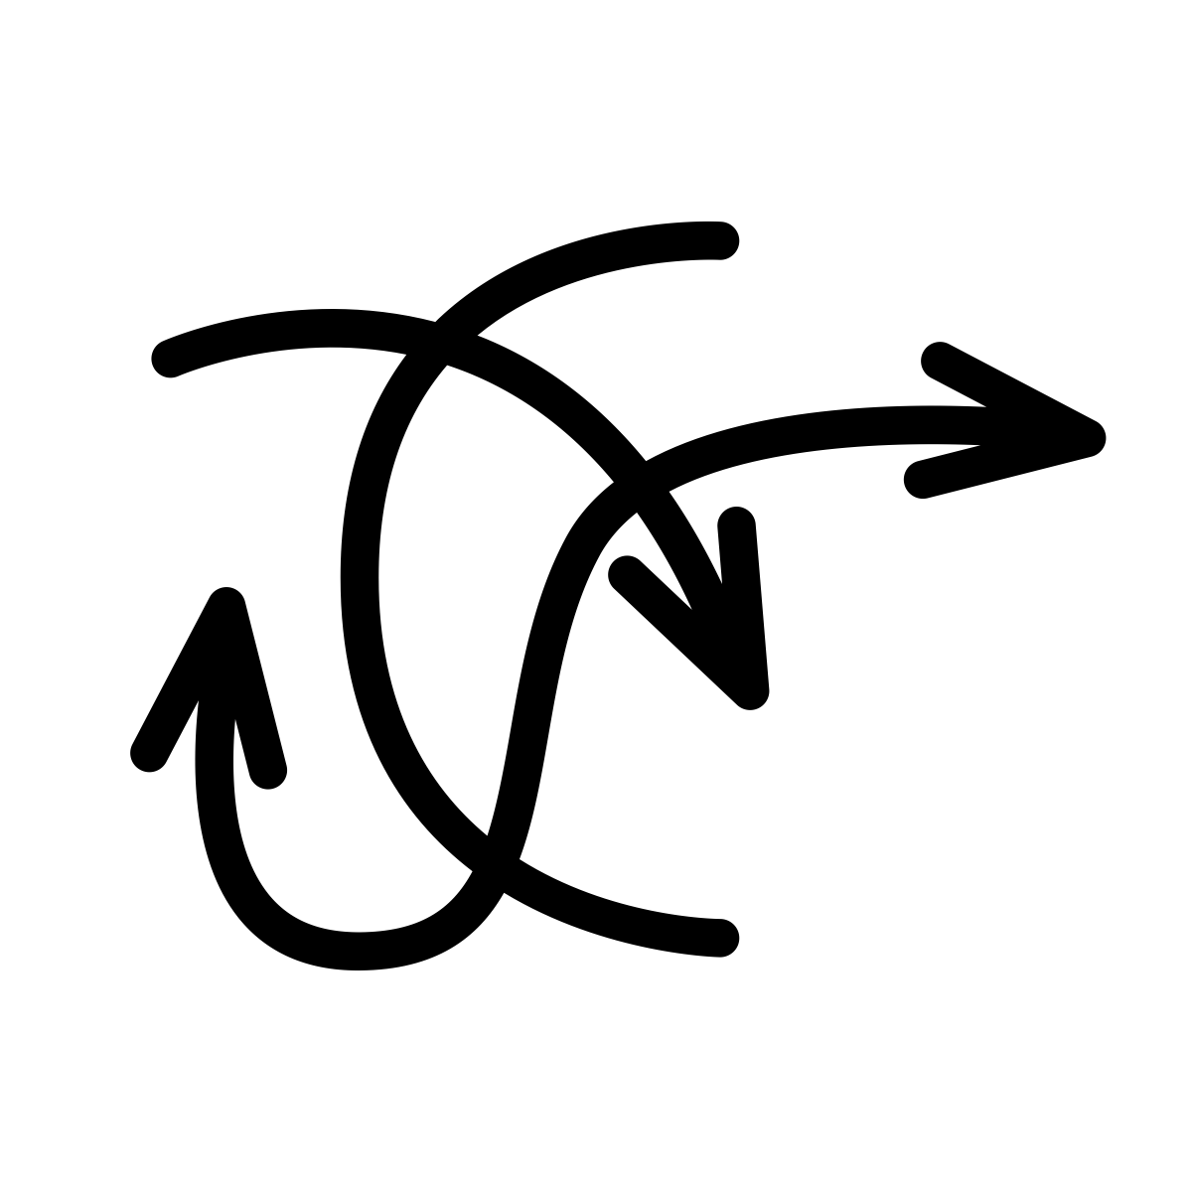


Intuit has access to very rich data
Small business transactions, financial transactions, tax returns, etc.
Categories of data
Machine learning dimensions
BE
Business events
Solve very complex tasks
BD
Behavioral data
Automate time-consuming activities
TD
Third-party data
Enable new insights
3 categories of data power 3 dimensions of ML
Notes:
Speak to the number of users (~ population of the UK) , types of data (SMB
Combine with 6
Introduce types of data in slide 6
Do same thing for categories

Slide 7


Data pipeline
Back office systems
Transactional systems
Enterprise
Marketing
Customer
Care
Small
Business
Tax
Consumer
1. Business events
Machine
learning
Analyst
tools
Publish
Clickstream
2. Behavioral
data
Ingest (real-time)
Ingest
Consume
Consume
3. Third-party
data
Ingest (batch)
ETL
Data lake
MPP
BE
BD
TD
Notes:
3 types of data
1: Business events
2: Behavioral data
3:Thirdparty data

Slide 8
Our implementation
Back office systems
Transactional systems
Enterprise
Marketing
Customer
Care
Small
Business
Tax
Consumer
1. Business events
AWS
SageMaker
Tableau
Qlickview
Publish
Clickstream
2. Behavioral
data
Kafka
Ingest
Consume
Consume
3. Third-party
data
Sqoop
ETL
S3
Vertica
Notes:
Journey – hand coded -> models deployed to Yhat -> SageMaker working closely with amazon etc

Slide 9
Machine learning environment
Online real-time
Business events
Features
Score
Insights
Behavioral data
Business events
Offline batch
Develop
Train
Score
Behavioral data
Data lake
Third-party data
Both online and offline ML environments

Slide 10

Use case 1: Managing transactional risk (Payments)
Description: Judge the risk of a single financial transaction in real-time.
Model basics:
Features: Merchant, customer, transaction
Training: Batch against business event & third-party data
Scoring: Real-time scoring against business event data
Benefit: Looking at risk at the transaction level allows us to better protect the merchant from fraudulent transactions. Using ML gets you to a much better loss profile than using rules alone.
BE
TD
Notes:
Organizational principles
Segments
Difficulty
timeline
PrComplex task using Business Event Data and Third party data
Merchant Features:
Counterparty features:
Transaction features:

Slide 11
Managing transactional risk
Online real-time
Business events
Features
Score
Business events
Offline batch
Develop
Train
Data lake
Third-party data
Batch training, run-time scoring

Slide 12

Use case 2: Automating financial transaction categorization
(QuickBooks Online)
Description: Small businesses and the self-employed have to categorize financial transactions to an account.
Model basics:
Features: 235 distinct features including amount, merchant, institution type
Training: Batch against business event & third-party data
Scoring: Real-time scoring against business event data
Benefit: Categorizing transactions can take time, is tedious and can be error-prone. Using ML to automate, we’ve gotten to a 70-80% success rate.
BE
TD
Notes:
Training data spans over billions of unique words and word pairs. 100M reviewed transactions marked as business or personal to train the model. Scoring done when
data is imported from Financial Institution

Slide 13
Automating financial transaction categorization: run-time
Online real-time
Business events
Features
Score
Business events
Offline batch
Develop
Train
Data lake
Third-party data
Batch training, run-time scoring

Slide 14

Use case 3: Personalized experiences (TurboTax)
Description: Provide better and more contextual in-product help. Predict relevant and popular FAQs based on specific customer tax profile info and screen help accessed.
Model basics:
Features: Current year and prior year, product usage, e-file status
Training: Batch against business event & behavioral data
Scoring: Real-time scoring against business event & behavioral data
Benefit: Helps users navigate the product, reducing care contact rate by 2 points and increasing customer engagement by 3.5%.
BE
BD

Slide 15
Personalized experiences: run-time
Online real-time
Features
Score
Behavioral data
Business events
Offline batch
Develop
Train
Behavioral data
Data lake
Batch training, run-time scoring

Slide 16

Use case 4: Matchmaking (experimenting with ML in
QuickBooks for Accountants)
Description: Find the right match between an accountant and a small business.
Model basics:
Features: Accounting firm, small business, historical data
Training: Batch against business event & third-party data
Scoring: Offline against business event & third-party data
Benefit: By year 5, half of small businesses fail. They’re 50% more likely to survive if they get help from an accountant. Having the right accountant
increases that likelihood.
BE
TD

Slide 17
Matchmaking: run-time
Online real-time
Insights
Business events
Offline batch
Develop
Train
Score
Data lake
Third-party data
Trained and scored offline

Slide 18
Use case 5: Cash flow projection
Description: Given the history of a business’s transactions and similar small businesses, predict the cash flow of a small business.
Model basics (predict and then forecast):
Features: Financial transactions
Training: Batch against business event & third-party data
Scoring: Offline against business event & third-party data for an individual
Benefit: Small business owners can manage their cash flow proactively, making adjustments before they run out of money.
BE
TD
Notes:
The purpose of the prediction engine is to, for a given user, predict new transactions. This primarily includes transactions that haven’t occurred; it might also include transactions that have occurred but are not yet in the system (e.g. haven’t been entered by the user). Predictions are made primarily based on each user’s historic transactions.
The cash flow engine deals primarily with creating/updating predictions and forecasts based on an individual user’s data. Although data and information from other users may go into the predictions, these do not need to be updated for real-time or interactive predictions. Hence, any logic depending on other user data will be built ahead of time (in a batch mode) and made available to the cash flow engine. There are at least two key modules that must be supported:
Bayesian Probability Distribution. These will represent distributions for the overall population and perhaps additionally for certain segments. They may be updated in the cash flow engine based on data for the individual user.
Machine Learning Model. These will be trained on a larger set of user data and made available to the cash flow engine for use when predicting for an individual user.
Prediction Engine: Predict transactions. The prediction engine must support a variety of methods (or algorithms) for predicting transactions. We will internally develop algorithms based on data (historic and cross-company) in order to predict transactions. The goal of these algorithms is solely to make the most accurate predictions of transactions for any user given all available relevant information. Additionally, we will want to allow the user themselves to specify various algorithms for prediction or scenario planning. These could include algorithms based on budgets, formulas, or even just the user’s own innate knowledge of their business. These algorithms must also be expressed and executed in the prediction engine. In all cases, the output is a set of predicted transactions.
Forecast Engine: Aggregate transactions. The forecast engine applies the appropriate aggregation to the appropriate set of transactions (historic, predicted, recurring/scheduled, scenario planning, etc.) to produce statistical measures associated with a specified cash flow quantity. For example, a quantity of interest could be the amount of cash on hand on a given day and the statistical measures used to quantify this could be an estimated value along with lower and upper bounds. The user or client must directly or indirectly specify the quantities and statistical measures of interest. In order to support a full range of statistical measure on the result, aggregation of predicted transactions must propagate the associated measures of uncertainty to produce a result with its own measure of uncertainty.

Slide 19
Predictions and insights: run-time
Online real-time
Insights
Business events
Offline batch
Develop
Train
Score
Data lake
Third-party data
Trained and scored offline

Slide 20
Key takeaways
Unlock the power of many for the prosperity of one
Machine learning is changing the way we think about products
Machine learning can be used to solve a number of types of problems
Different categories of data can be combined and used online and offline
BE
BD
TD

Slide 21

Q&A
Calum_Murray@intuit.com

